Slide 1
PCC5 Supervised learning
IE 4910
James Sloan 4/8/20

Slide 2
Algorithms Used
SVM: Support Vector Machines
DT: Decision Trees
RF: Random Forests

Slide 3
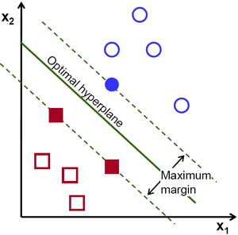
SVM: Support Vector Machines - Explained
SVM plots categorical training data in n-dimensions
Where n = number of (x_{i}) input variables
Then it separates data by creating n-dimensional hyperplanes (shown in 2d) between each category
This effectively “chunks” classified training data into spatial regions.
Each classification has its own dedicated region
By using these spatial definitions, new data can be classified by inputting their parameters and seeing what region they fall into.
Varying the parameter C effectively adjusts the allowable error in training by determining how many data points are allowed to lie within the maximum margin.
This can adjust the effect of outliers to create more realistic and powerful prediction

Slide 4
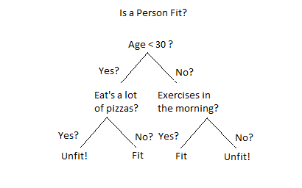
DT: Decision Trees - Explained
Decision trees are basically algorithmically generated flow charts.
They look at data and build a “tree” of “decisions” (hence the name) that eventually filter down to the identified output or y-variable.
The main parameter to change is the “max depth”, which limits the number of decisions made before an answer.
High max depth usually leads to good fit, but may lead to overfitting for the data at hand

Slide 5
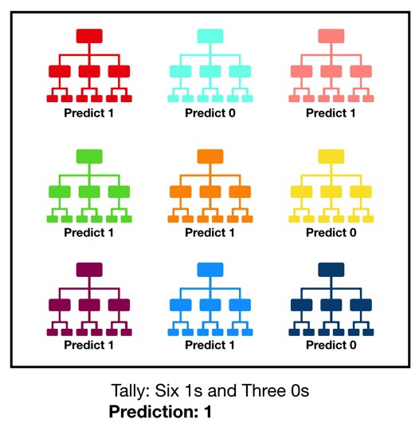
RF: Random Forests - Explained
Random forests are made of many decision trees.
Each decision tree makes a prediction independently
Then the forest takes the most “popular” prediction and uses that
Very simple in nature, but they can quickly become computationally taxing
To change the nature of the forest, two parameters can change
Number of estimators
# of first level decisions used by any one tree
Max “leaf” nodes
# of nodes at the bottom level of each tree

Slide 6
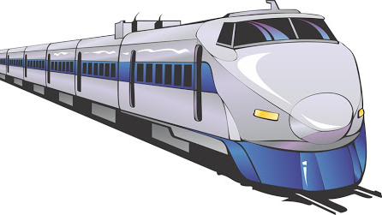
Train Dataset
Predicting Ticket Type

Slide 7
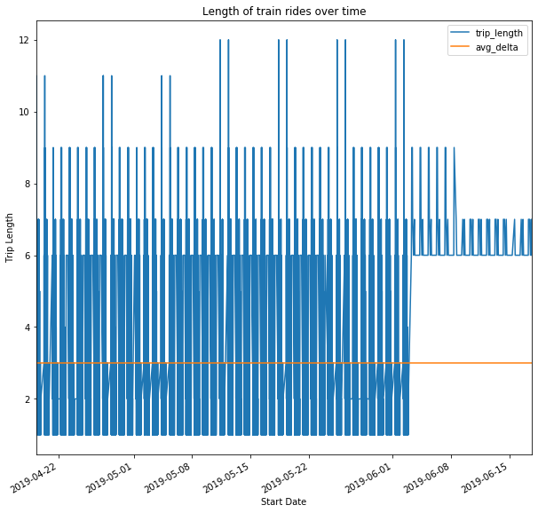
Length of train rides
Seems to be “seasonal”
Repeating pattern
Change in pattern starting 6/01/19
No more very short or very long trips
Average is pulled down by the very frequent short trips

Slide 8
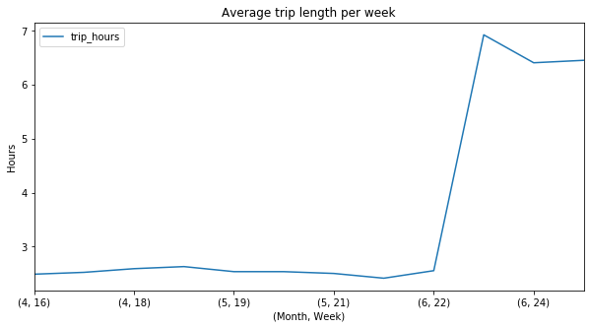
Trip length average by week
Most trips are very short until 6/22 when the pattern changes
This could be a cancellation of local trips for some reason

Slide 9
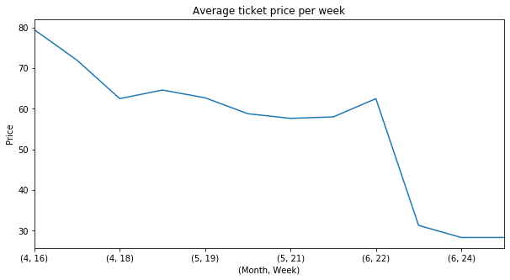
Ticket price average by week
Ticket prices start very high
Go low when the trips become more uniform in length
Could indicate a decrease in cost associated with simplification of scheduling
Could also indicate the company capitalizing by surge pricing for seasonally busier times

Slide 10
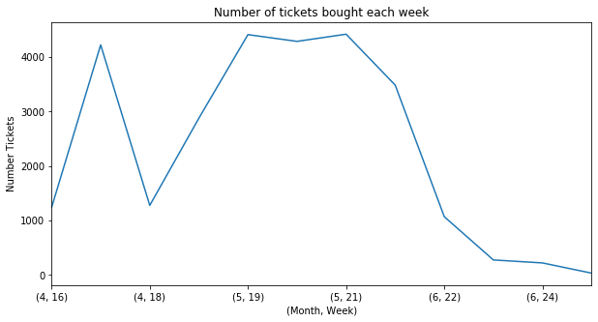
Number of tickets by week
Most variable of the three weekly metrics
Decrease in tickets right before changes indicated in previous graphs
Could indicate business responses to lower demand

Slide 11
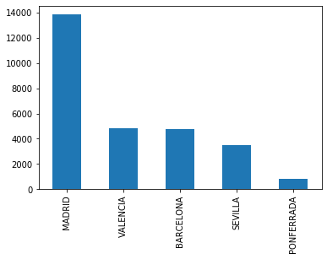
Destination
Low number of unique destinations
Madrid is most popular destination by far, and is surely driving our other metrics

Slide 12
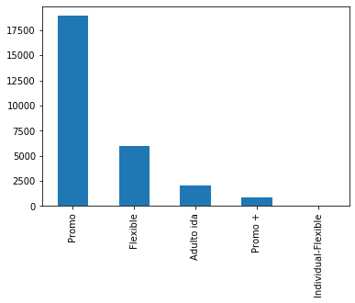
Fare
Most tickets are Promo
Could indicate a special event like a major soccer game that was linked to a promotion

Slide 13
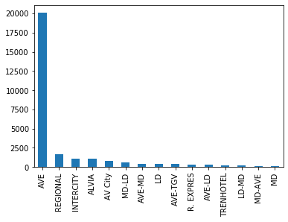
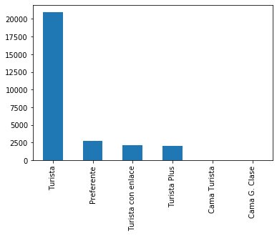
Train Type & Train Class
Most common by far is AVE type and Turista class
Other types and classes make up very small proportion of total

Slide 14
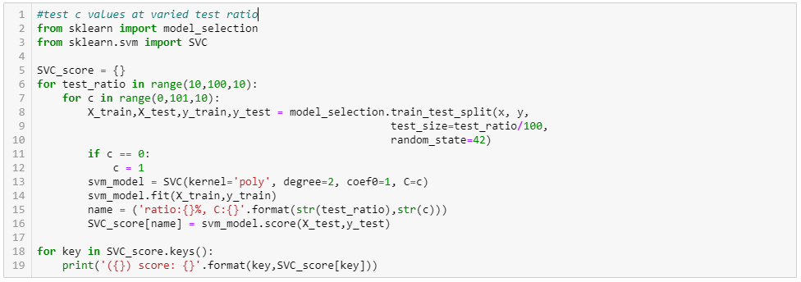
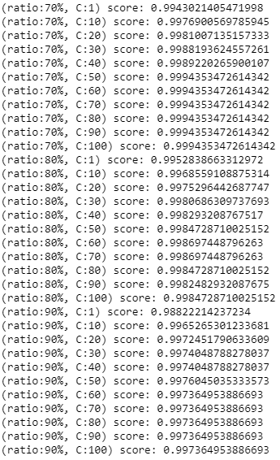
SVM: param analysis
Iterated over varied test ratio size and varied C
Test ratio from 10% to 90% by 10% increments
C from 1 to 100 by increments of 10
Best C across all test ratios appears to be C=50
Results after that point are equal or insignificantly better

Slide 15
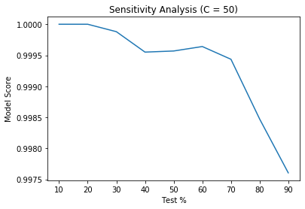
SVM : Sensitivity analysis
Set models to 60% test
Local maximum before decline towards 90%
Very high scores regardless
Leads me to believe that the algorithm is emulating the company’s internal pricing model.

Slide 16
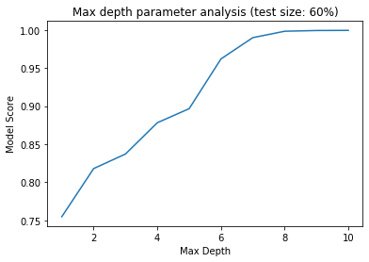
DT: param analysis
Iterated Max Depth from 1 to 10 by 1
Set model to Max Depth = 8

Slide 17
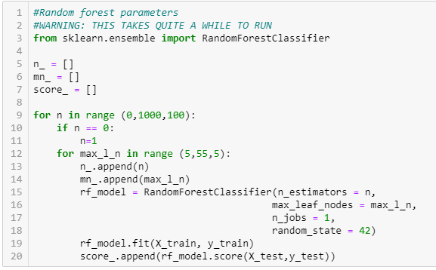
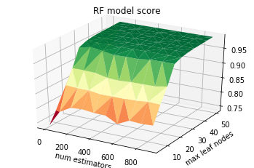
RF: Param analysis
Iterated number of estimators and max leaf nodes
Estimators from 1 to 900 by 100
Nodes from 5 to 50 by 5
Plotted in 3 dimensions to easily visualize each parameter’s effect
Max leaf nodes seems to have greater effect
Chose number of estimators = 200, max leaf nodes = 20

Slide 18
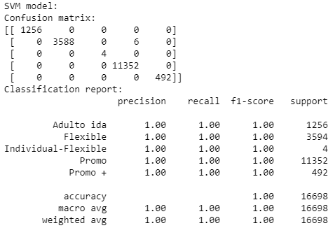
SVM Summary
SVM had almost perfect prediction
Likely it recreated the companies internal pricing method
Only 4 total mistakes
Useful for future predictions for this company ONLY

Slide 19
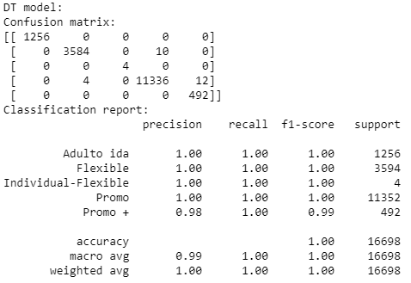
DT Summary
DT was also almost perfect
A few more errors that SVM
26 total errors
Useful for predictions with this company ONLY

Slide 20
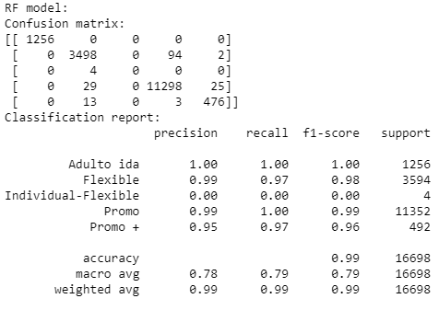
RF Summary
The worst of the bunch
Still almost perfect
170 errors
Slightly more useful for general predictions
Still most likely only useful for predictions with this company

Slide 21
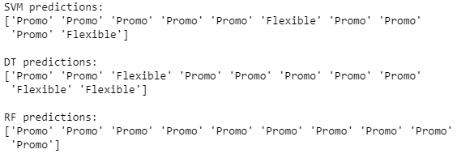
Conclusions & Predictions
All models had extremely high scores
0.99 – 1.0
Indicative of overfitting, these models are likely only useful for this particular company and this particular region of operation
SVM seems best (6 misclassifications)
It has the lowest instances of incorrect classifications
DT is second best (26 misclassifications)
RF is last (170 misclassifications)
Predictions for each model type based on random input is shown below
With “Promo” being the overwhelming majority, all methods tend to predict this in most random cases
SVM is the best predictor, least errors in confusion matrix

Slide 22
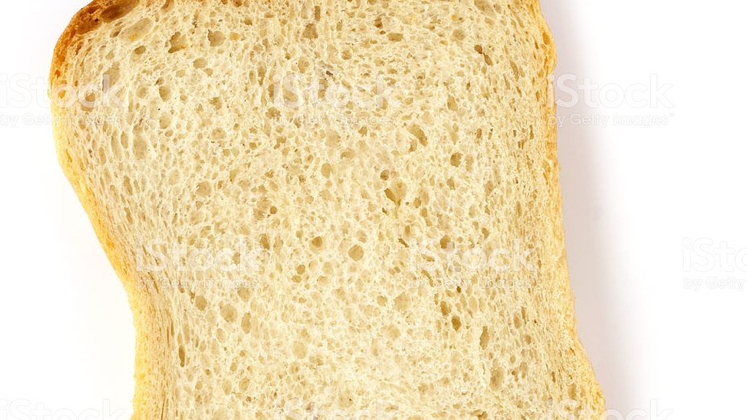
Bread Dataset
Predicting the quality of bread

Slide 23
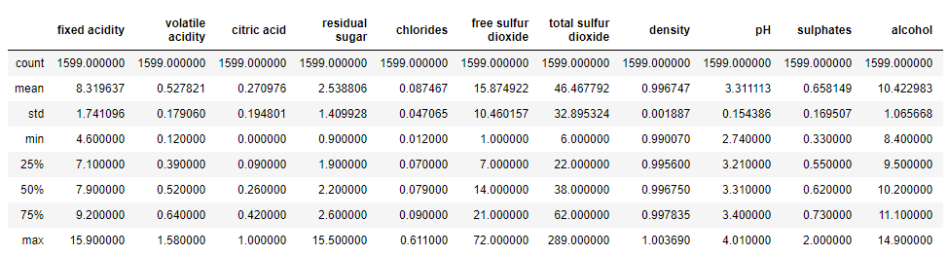
Stat summary
1599 total data points
(‘fixed acidity’, ‘residual sugar’, ‘free sulfur dioxide’, ‘total sulfur dioxide’, and ‘alcohol’) have standard deviations > 1. All other categories have very low variance
Indicates that other categories are mostly set to preferred values.

Slide 24
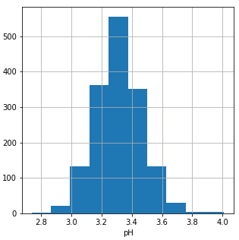
PH
PH seems to be normally distributed about its mean of approximately 3.3
Relatively little variation

Slide 25
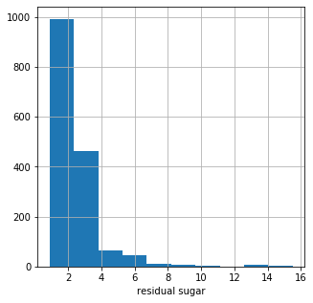
Residual Sugar
Cut-off point above 0, likely indicates a lower detection limit of the equipment.
In general, it seems smaller is better

Slide 26
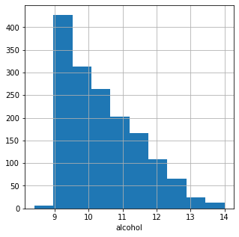
Alcohol
Cut off just below 9
Could indicate sensor detection limit
However, it’s relatively high value is better explained by a process control throwing out anything below this point.
Could also indicate a minimum level needed for the process to work at all

Slide 27
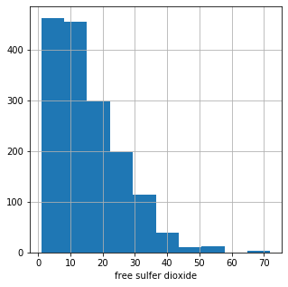
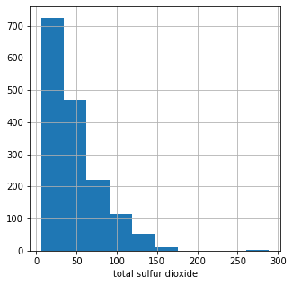
Free sulfur dioxide
Fairly high variability
Average level is very low, but some values appear to be outliers
Total sulfur dioxide
Similar variability to ‘free sulfur dioxide
Likely highly correlated

Slide 28
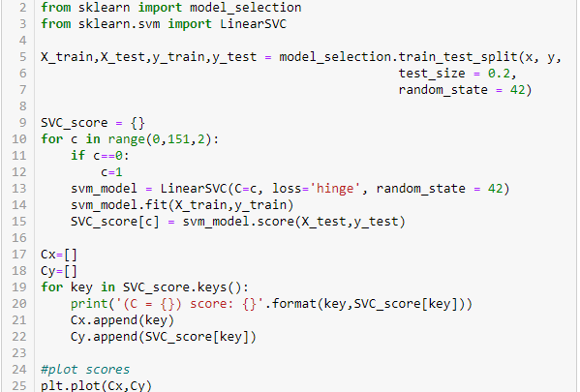
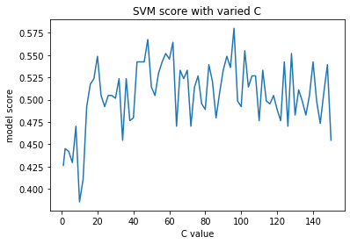
SVM parameter analysis
Tested with 20% test ratio
Varied C from 1 to 150 by 2
Lots of noise at this scale
Chose C=48 which is a local maximum

Slide 29
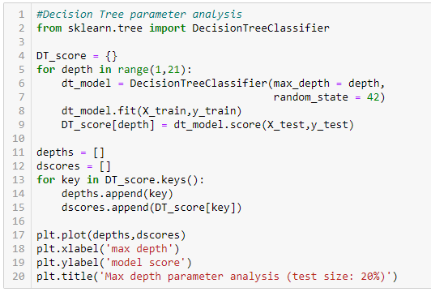
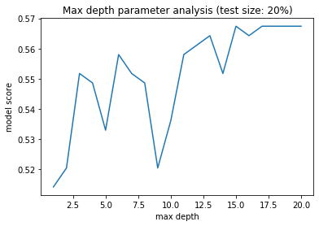
DT parameter analysis
Tested with 20% test ratio
Varied max depth from 1 to 21 by 1
Lots of noise at this scale
Chose max depth = 6 which is a local maximum, and avoids overfitting as much as the higher depth values

Slide 30
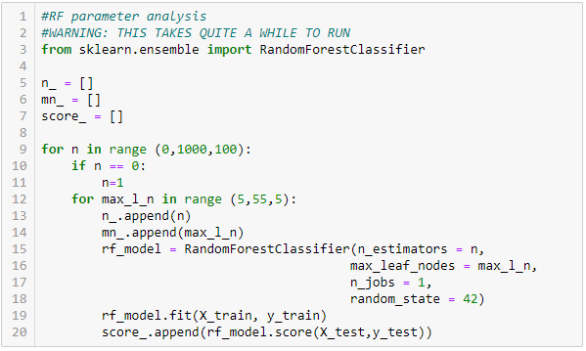
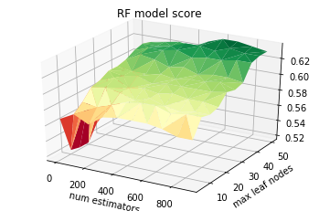
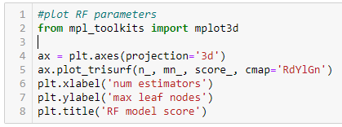
RF parameter analysis
Tested with 20% test ratio
Varied number of estimators from 1 to 900 by 100, varied max leaf nodes from 5 to 50 by 5
Used plot_trisurf to create surface based on these parameters and the model score
Used the surface to choose number of estimators = 600, and max leaf nodes = 50

Slide 31
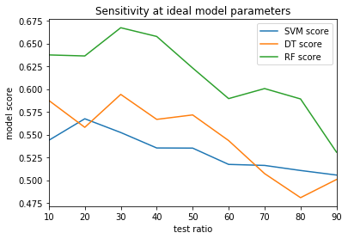
Sensitivity analysis: All methods
Used the model parameters found in previous slides
Iterated from 10% to 90% test ratio
Chose 30% as it is a local max for 2 of the 3 methods
RF appears to be the best method at first glance

Slide 32
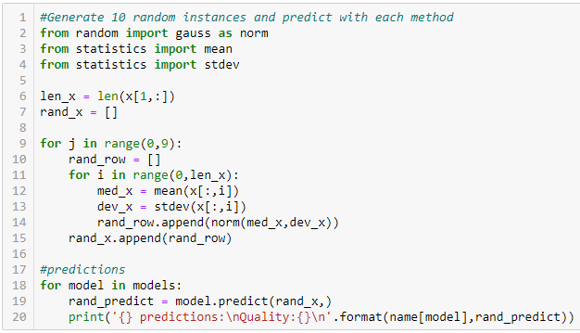
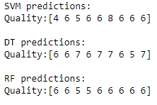
Predictions
Used the mean and standard deviation of each input variable to create a random sample of 10 points
DT and RF tend to bias most of their answers to their “favorite” 2 outputs
Not a whole lot of agreement between the 3 methods
Tend to be in the same general range, but rarely agree on the exact quality score

Slide 33
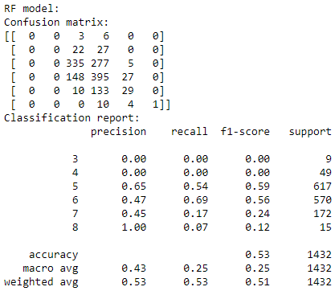
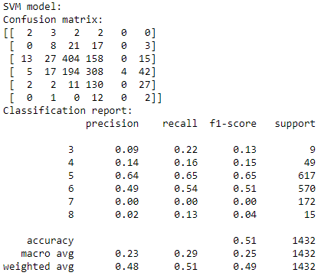
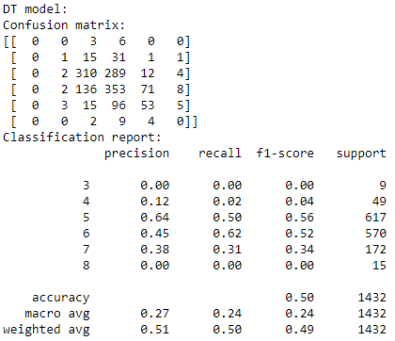
Method Summaries
RF Summary SVM Summary DT Summary
RF failed to predict a single instance of the two lowest quality scores
DT failed to predict any of the single lowest quality scores
Model scores varied from 0.50 to 0.53
Given this small range, SVM seems the best. It tends to undershoot quality which is a much safer direction to bias for customer satisfaction
I recommend using the SVM model for future predictions

Slide 34

Hotel Dataset
Predicting whether or not a cancellation will occur

Slide 35
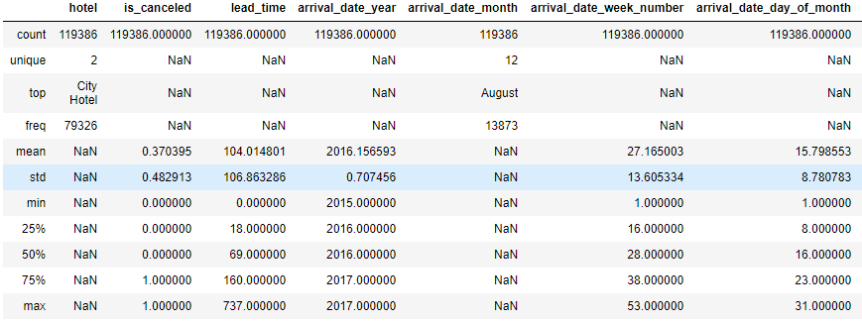
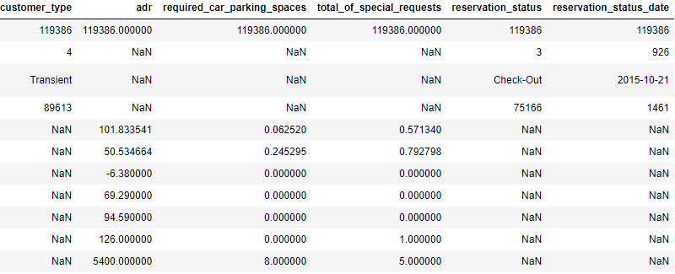
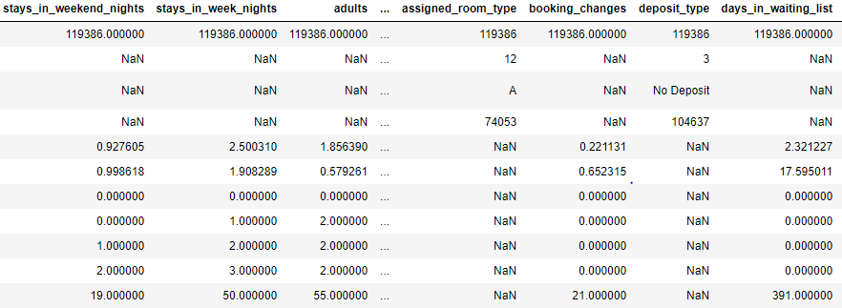
Statistical summary
The data has almost 120k data points ranging from 2015-2017
Majority “City Hotels”, located in the US, region of the Country unspecified
We will focus on the (“deposit_type”, “lead_times”, and “arrival_date_month”)

Slide 36
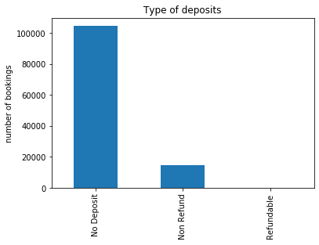
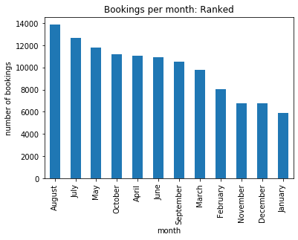
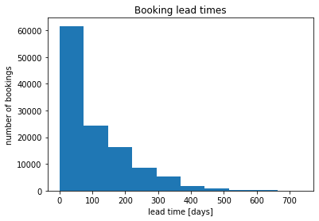
Parameters of interest
To predict cancellation

Slide 37
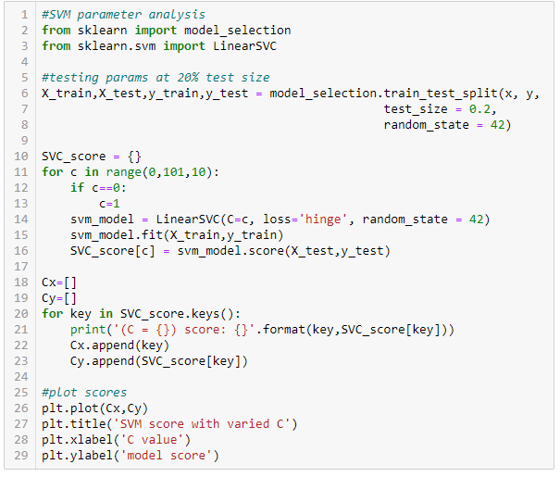
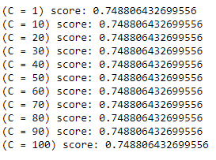

SVM: param analysis
C appeared to have no effect on model score
Unsure of reason why
Left C = 1

Slide 38

DT: param analysis
Peak at max depth = 25
This is the value chosen for all further analysis

Slide 39

SVM: param analysis
Same method as before
Due to large size of data, less points could be reasonably calculated
Num est from 1 to 100 by 10
Max nodes from 5 to 25 by 5
Chose num est = 1, max nodes = 25

Slide 40

Sensitivity analysis: All models
DT and RF are fairly flat
SVM appears to be overfitting
Chose 80% test to highlight predictive capability of DT and RF

Slide 41

Predictions
Used the mean and standard deviation of each input variable to create a random sample of 10 points
SVM and RF have similar outputs, with SVM tending to bias toward 1 slightly more than RF
DT has some agreement with the other two methods, but not very much

Slide 42



Method Summaries
RF Summary SVM Summary DT Summary
0 : no cancellation, 1 : cancellation
Model scores were very close, ranging from 0.74 to 0.75
DT did marginally better predicting no cancellation (+2% precision) but far worse predicting cancellation (-20 to 28% precision)
SVM missed only 1% of cancellations, and did better than RF in most measures
I recommend SVM for further predictions

